Slide 1


Expertise Aware Content Customization
Suha Siddiqui
suhasid098@gmail.com
Professor Maleknaz Nayebi
Notes:
Hello everyone my name is suha siddiqui and I was a USRA researcher this summer in the EXINES lab @york. You can scan the QR code above to get into contact and know more about me. and today i will be introducing to you my research project, expertise aware content customization

Slide 2




How many of us have felt lost in class before?
Notes:
Am I the only one that not known whats going on in class before?
Let's face it we have all been in a class at some point and felt lost to some degree. But what it comes down to is the course of action you decide to take after. I think there are at least 1 of 3 actions. 1. You abandon it, or give up
2. You reach out to you prof or ta for further explanation
3. You find some help online or ask your friends
At the end of the day what you know and what you dont is completely circumstantial to everyone, and the professor cant tailor to everyones unique knowledge backgrounds

Slide 3

Not an expert?
No problem.
Notes:
But this doesn’t only apply to educational scenarios. The “one size fits all” approach to setting instructions clearly doesn’t work to support everyones understanding. For example, putting ikea furniture together is notorious for being frustrating due to lack of description. Clearly people need more than just pictures to figure out what they are doing. Although, ikea does offer an assembly service letting someone more skills and experienced handle the task. But we can’t always rely on expert services for other situations

Slide 4










API’s and Documentation
APIs offer services to other systems and connect software systems together
Machine learning APIs are rising in demand
API documentation can be technical
Users of such APIs are not software expert
Notes:
In software systems, APIs are the interfaces that offer services to other systems and can connect software systems together. machine learning is quite on demand and people which are not software engineers try to use the software which is designed to implement ML models .... they are not software experts sooo they don't really get all the API documentations similar to us being lost in the class

Slide 5
Our Case Study: TensorFlow
A popular Machine Learning API library
TensorFlow APIs have wide variety of API symbols
Offers tutorials geared towards different levels of familiarity with API
Notes:
Tensorflow is a popular machine learning library and offers a wide variety of functionality
There are tutorials geared to cater towards different levels of familiarity
It is popularly discussed across many social media platforms

Slide 6
Our Objective
How user expertise have been considered in TensorFlow API Documentation?
What model adjusts API documentation based on user expertise?
What are the TensorFlow users' levels of expertise that we wish to cater the documentation to?
Notes:
So to break down the objectives our research the two questions
How user expertise have been considered in TensorFlow API Documentation?
What model adjusts API documentation based on user expertise?
What are the TensorFlow users' levels of expertise that we wish to cater the documentation to?

Slide 7
Readablity Level Metrics
Flesch Reading Ease
100
90
80
70
60
50
40
30
20
10
0
“Very Easy”
“Standard English”
“Difficult”
“Very Difficult”
Flesch-Kincaid Grade
0
2
4
5
6
8
10
12
14
16
18
“New to Reading”
“Harry Potter”
“A Brief History of Time”
“Academic Paper”
Gunning Fog Index
0
2
4
6
8
10
12
14
16
18
20
7
“6th Grade”
“High school sophomore”
“Post Graduate”
7
Notes:
I have mentioned the term “expertise level” quite a few times. The way we are measuring it is using a readability levels evaluated by three metrics called Flesch reading ease from 100 to 0, flesch kincaid grade which runs from 0 to 18, and gunning fog index runs from 0 to 20 being easy to hard, respectively. I have pointed out placed in the scales that equate to certain text levels. Readibility “ease” is associated with complexity and terminology. When direct terminology is used it implies complexity because it means that the basis of the topic being discussed has a level of assumption that there is prior knowledge and existing bakground

Slide 8
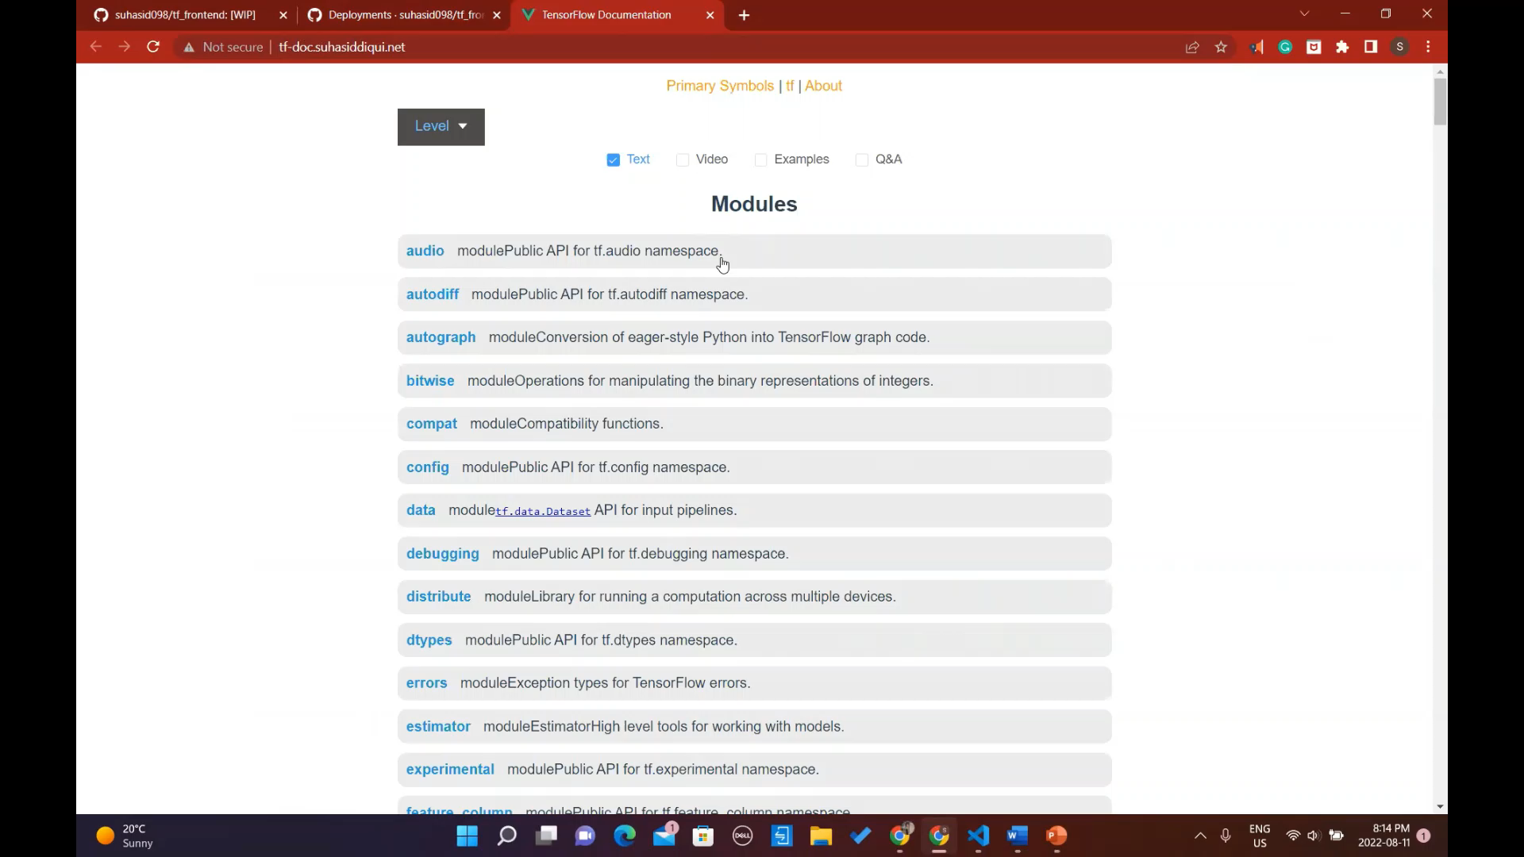

Slide 9


TF Original Doc
TF = “TensorFlow”
ML = “Machine Learning”
Docstring
ML PROCESS
User viewing TF API doc
User picks preferred level of expertise
Docstring calls original TF documentation
Output published on web
Customizes original API doc with collected resources
Gathers related videos, text, examples, and Q&As
ELSU Parser
Notes:
Before I get into more details about the results and findings I will explain our methodology. Setting the scene, the user should be viewing the tensorflow api documentation. The user should be able to pick their desired level of understanding like beginner for example. We will be using Python docstrings which are strings used right after the definition of a function, method, class, or module . They are used to document our code. For our purpose its needed to pull original tensorflow documentation. Then our parser will calculate the readability score on tensorflow tutorials. Then it gets handed off to our machine learning process which I will get into after this. Using the machine learning process it will classify the tensorflow api documentation. Then it will gather the crawled videos, text, examples and QnAs. and the output should be customized to the users preference displayed on our site.

Slide 10
TF = “TensorFlow”
ML = “Machine Learning”
Precision
Beginner Tutorial
Calculating Readable Score
Training ML using scores
Cross Validation
Recall
FK-score
Calculating readability per API documentation
Data looks like (Readability Scores)
Advance Tutorial
Predicts expertise level of API documentation and labels API
*Labels Included
Machine Learning Process
Notes:
This is our ML process where it is fed beginner and advance tutorials using a python library called text stat to calculate readability scores. The tutorials scores are used to train the machine learning model. We use cross validation to evaluate results of the trained machine learning model. With the best cross validation score we can label the api documentation as different levels

Slide 11
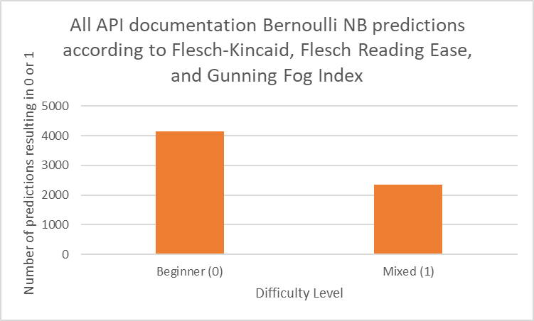
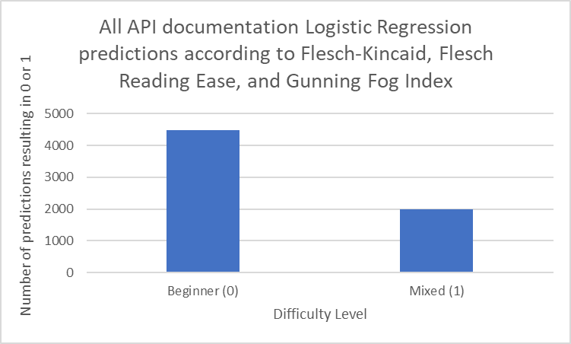
Cross Validation and Machine Learning Prediction
Logistic Regression returned the best results
Bernoulli Naive Bayes was run to validate the predictions
 | Score
Recall | 1.0
Precision | 0.63
F1 | 0.77
Accuracy | 0.70
Notes:
So as mentioned earlier we has to perform cross validation and found that logistic regression returned the best results out of all tested machine learning models. We conducted undersampling on the training data set which was taken from the TF tutorials which were predetermined as beginner or advanced.
And we used bernoulli naive bayes to validate our predictions because of the recall score on the logistic regression.

Slide 12
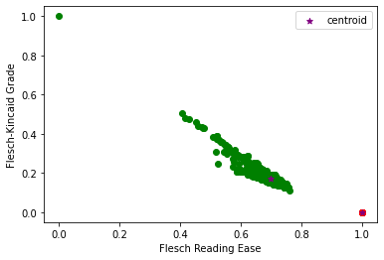
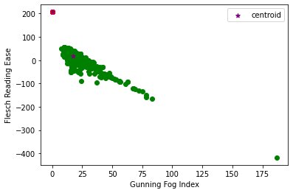
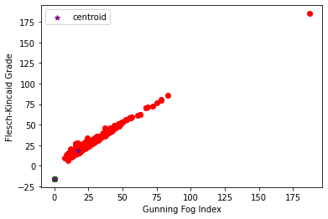
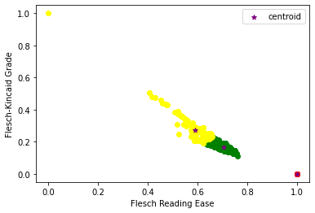
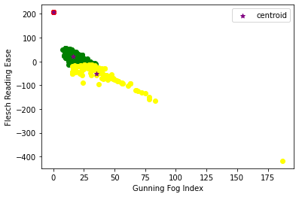
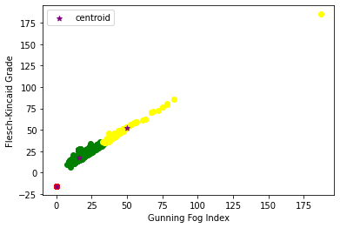
K = 2
K = 3
Determining expertise level of TensorFlow APIs
Notes:
We determined the range of expertise level using k means clustering on classified api documentations.
We tested with k=2 and k=3, k representing the number of levels using Flesch Reading Ease, Flesch-Kincaid Grade, and Gunning Fog Index (we produced 6 graphs). Here is an example portraying Flesch Reading Ease vs Gunning Fog Index. When k=2 you can see a big blob and a red blob containing a small group of outliers.
But when k=3 there are two distinct groups around the big group with yellow and green and the same small group of outlier in red.
Given the proximity of the clusters, it suggests that there is a beginner and mixed group.

Slide 13
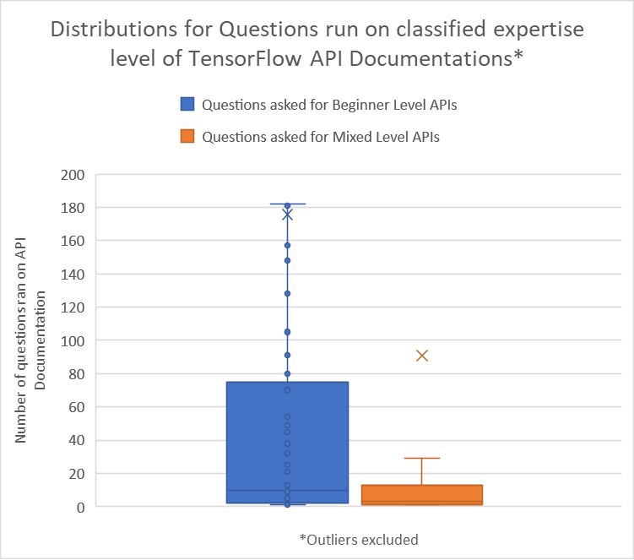
Distributions of Questions ran on varying expertise level
Notes:
Based on the previous charts, you may have noticed that there were more beginners than advanced api documentations, which sort of contradicts the concept of “readibility” improving understanding. We collected data on the specific apis which had questions and compared it with api level, we found there were more questions on beginner level apis, which proves that regardless of expertise level text simplification is necessary with the addition of external resources

Slide 14
Before | After
… but keep in mind that tf.function only executes such code at trace time, and generally will not be consistent with eager execution. | …but keep in mind that tf.function only runs such code at trace time, and generally will not be agreeing with/matching up with/working regularly with eager execution.
Text Simplification with EASSE (Easier Automatic Sentence Simplification Evaluation) and ACCESS (AudienCe-Centric Sentence Simplification)
Notes:
Now, Text simplification is a major part of this project. EASSE (Easier Automatic Sentence Simplification Evaluation) and ACCESS (AudienCe-CEntric Sentence Simplification) are tools which can take text and simplify the api documentation down in terms of specialized or complex terminology used. Simplifications can come down to be at the sixth grade level. Tested on the flesch Kincaid grade scale the before snippet is at a 11 to 12th grade level and the after snippet is at a 6th to 7th grade level

Slide 15


Impact
Notes:
I know its typical to include our UN sustainable development goals in the start but I chose to include it at the end. Our project intends to target the quality education un sdg goal as it makes learning about machine learning and software engineering expand to different knowledge backgrounds. We hope that on the completion of the goal it can help target goal 9 which target to help promote innovation in the industry ultimately improving research and devlepment in terms of efficiency

Slide 16



Future directions
User review and feedback
Apply to other areas of R&D apart from TensorFlow
Cater to more knowledge backgrounds levels
Notes:
Our future goals hope to get end user feedback to help validate the usage and efficacy of the tool
We also would to apply the our research to different facets not exclusive to machine learning
And would like to find more ways to cater to different knowledge backgrounds and needs to improve varying expert levels of understanding

Slide 17
